Slide 1
Mandated Reporter Training
Morrison County Health and Human Services
2023

Slide 2
Introduction
Children’s Intake Social Worker:
Abigail Mulic 320-632-0201
Adult Intake Social Worker:
Sarah Gilson 320-632-0329

Slide 3
Child Protection Overview
Child Protection cannot share any information unless there is a signed release of information. (Even if you know there is County involvement)
When making a report, we can take as much information as you are able to give, we cannot give any information.
You are able to reach out to Intake if you feel the family would benefit from other services such as PSOP, AMH, CMH, or waiver services.
Other services are VOLUNTARY, and unless there is a signed ROI we cannot say if the family accepted or not.

Slide 4



Mandated Reporter – Key Components
Who
What
Where
When
Why
How

Slide 5
WHO are Mandated Reporters
MN Statute 626.556 Subd. 3, (1-2)
(a) A person who knows or has reason to believe a child is being neglected or physically or sexually abused, as defined in subdivision 2, or has been neglected or physically or sexually abused within the preceding three years, shall immediately report the information to the local welfare agency, agency responsible for assessing or investigating the report, police department, county sheriff, tribal social services agency, or tribal police department if the person is:
  (1) a professional or professional's delegate who is engaged in the practice of the healing arts, social services, hospital administration, psychological or psychiatric treatment, child care, education, correctional supervision, probation and correctional services, or law enforcement; or
  (2) employed as a member of the clergy and received the information while engaged in ministerial duties, provided that a member of the clergy is not required by this subdivision to report information that is otherwise privileged under section 595.02, subdivision 1, paragraph (c).

Slide 6
WHAT to Report
Mandated reporters must report knowledge of an incident of:
  Physical Abuse
  Emotional Abuse
  Sexual Abuse
  Domestic Violence – if the child(ren) were involved or witnessed
  Neglect to a Child
    Medical –typically needs to come from a medical professional
    Lack of Supervision
    Dangerous Home Conditions
    Drug Use (Prenatal, Upon Delivery, While Parenting)
    Educational – typically needs to come from the school

Slide 7
Lack of Supervision
Reports alleging inadequate supervision or child care arrangements may be screened in for a child protection response, including children ages:
*7 and under left alone for any period of time
*8-10 left alone for more than three hours
*11-13 left alone for more than 12 hours
*14-15 left alone for more than 24 hours
*16-17 may be left alone for more than 24 hours with a plan in place concerning how to respond to an emergency.
Reports alleging inadequate child care arrangements may be screened in for a child protection response according to the following guidelines, children:
      *Under age 11 should not provide child care
      *Ages 11-15 placed in a child care role are subject to the same time restrictions of being left alone as listed above
      *Ages 16-17 may be left alone for more than 24 hours with adequate adult back up supervision.

Slide 8
Educational Neglect
The student has at least 7 unexcused absences
The school has already sent the continuing truant letters to the family. (include those in with report)
The school has reached out to the family to see what the barriers are for getting to school, and include all of this in the report. Since COVID, the State is encouraging schools to reach out to families before getting CPS involved.
Include the student’s attendance history in the report as well (with a key so we can understand it – every school is different)

Slide 9
Reporting Specific to Predatory Offenders
MN Statute 244.057 A corrections agency supervising an offender required to register as a predatory offender under section 243.166 shall notify the appropriate child protection agency before authorizing the offender to live in a household where children are residing.
If you become aware of a PRO living with children, make a CPS report ASAP.

Slide 10
WHAT to INCLUDE in the Report
What should you include in the Report?
  Name & DOB of Victim
  Names & DOBS of the other Children in home
  Names, DOBS, Addresses, Phone Numbers, & Custodial Status of Parents
  Name of Perpetrator & Relationship to the Victim
  Name & address of the reporter (for mandated reporters)
  AS MUCH INFORMATION AS YOU CAN, IS THE MOST HELPFUL!

Slide 11
WHAT to INCLUDE in the Report
  Nature & extent of maltreatment
    Date
    Type
    Impact
    Reactions
    Injuries – if possible, take pictures to send with report
The more information you have, the better it is for the screening team to be able to come to a determination of whether CP can be involved or not.

Slide 12
Types of Questions to ask…
Open Ended Questions – this way they cannot be answered with a yes or no.
This will allow the child to tell the story without being prompted.
You might have to ask close ended questions … the who, what, where, when, why questions.
Exception: If you have information that leads you to suspect that sexual contact has occurred between a parent (or person legally responsible) and a child, you don’t need to ask additional questions. This is because any type of sexual contact between a parent and child is always reportable.
Examples:
In response to open-ended question, child says, "My father hit me."
Where did this happen?
Why did he hit you?
What did he hit you with?
How often does this happen?
Examples:
I notice that you have a bruise. How did it happen?
Tell me more about that.
You seem to get angry when I asked you that question. (Pause to allow child to respond.)
https://www.dorightbykids.org/how-to-ask-questions/

Slide 13
Something to Think About…
…could the family benefit from other services and supports?
…is this report truly about the safety of the child(ren)?
…would I make this report if MY family looked like this?

Slide 14
WHERE to Report
Within the Family Unit
  Perpetrator is in a Caretaking Role
  Report to local CPS of county where family lives
Outside the Family Unit
  Abuse occurs in a Licensed Facility – REPORT to a Licensing Agency or CPS
  Other abuse outside the home – REPORT to Law Enforcement or CPS
CONFUSED? Call Local & we will direct you.

Slide 15
WHEN to Report
A verbal report must be made within 24 hours.
  320.632.0201
  The verbal can be left on Intake’s VM. PLEASE listen to the VM message. If Intake is out for a period of time you will be instructed to press “0” to speak to back-up.
A written report must follow the oral report within 72 hours OR LESS.
  Fax 320.632.0225
  Email: socialservicesintake@co.morrison.mn.us
  Morrison County website: https://www.co.morrison.mn.us/209/Child-Protection

Slide 16
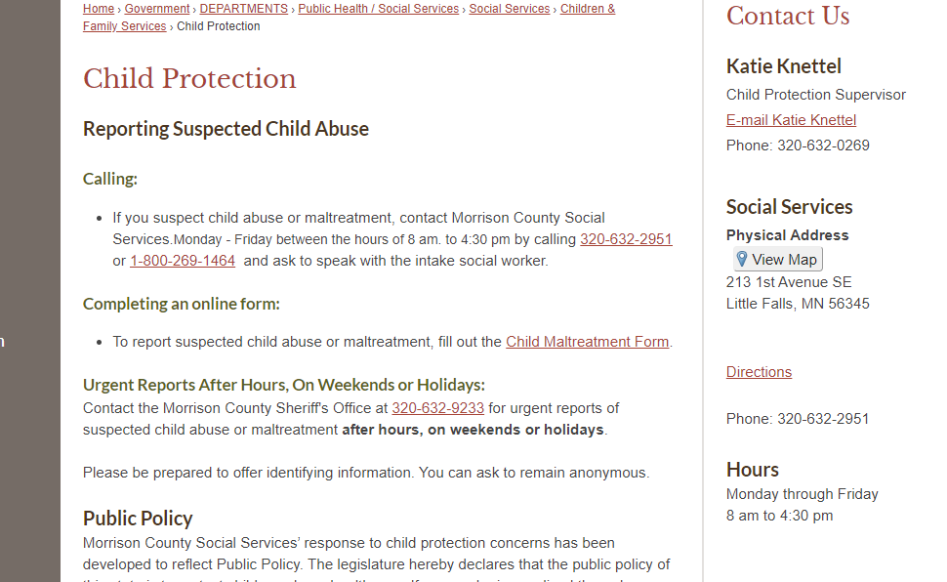
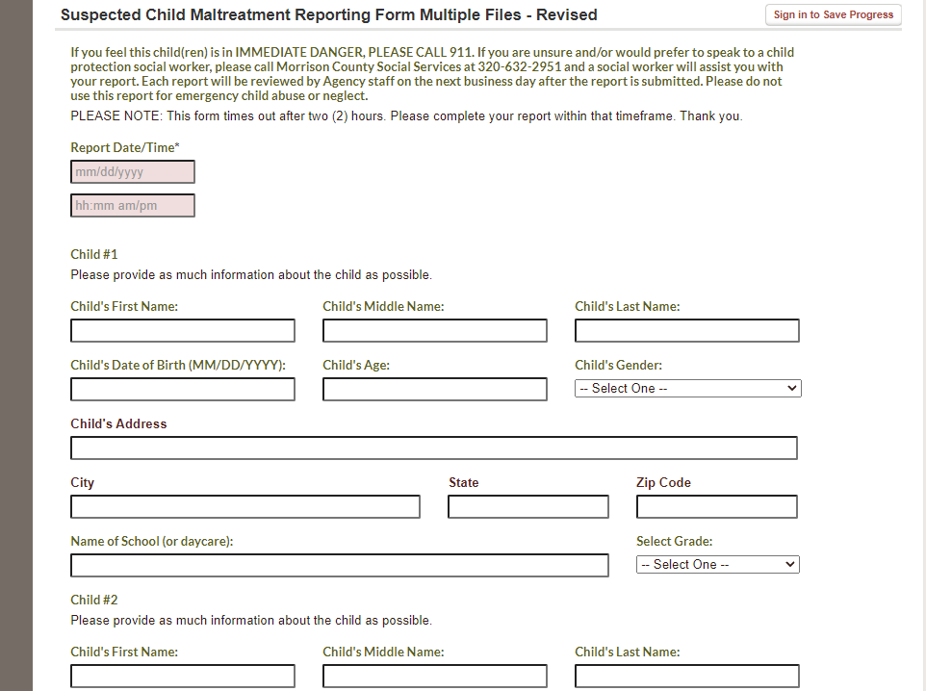
MCSS Online Reporting Form
-it may time out on you if you take longer than 2 hours, so we advise that you type it in a Word document and then copy and paste it to the form. It is important that you complete as much as the form as you can.

Slide 17
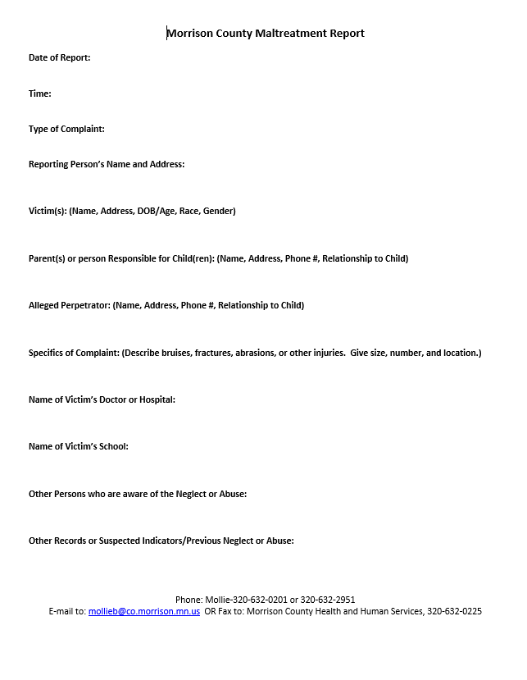
WORD Document Reporting Form
-Please save this as a WORD document and then email it to the socialservicesintake@co.morrison.mn.us email. It will be routed to the intake worker.

Slide 18
WHY Report
To Prevent harm to a child
To assist families in receiving needed services – just because you report to Child Protection, doesn't mean CP gets involved. Our agency will often times reach out and offer other voluntary services if deemed appropriate.
To disrupt or terminate a cycle of maltreatment – often times parents are doing “better” than what they know; and what they know may be abuse and neglect
It’s the LAW!

Slide 19
How MCHHS Responds to a Child Protection Report
Our CPS team needs to screen the report with 24 hours of receiving the report.
As a mandated reporter please put your work address on the form, per MN State Statue ALL mandated reporters are to get a letter with the screening decision. (Talk to your school social worker or principal to see what to do with those.)
If we screen a report out, we may offer voluntary services to the family.

Slide 20
How MCHHS Responds to a Child Protection Report
INVESTIGATION
  Required for severe harm/risk reports (substantial child endangerment)
  Immediate response (24 hours upon receiving report)
  Investigate & determine maltreatment & need for CP Services
  Law Enforcement typically assists on these
FAMILY ASSESSMENT
  For moderate and low risk cases
  Up to 5 day response time (120 hours upon receiving report)
  Determine need for services/case management services.
  Law Enforcement doesn’t typically assist on these

Slide 21
REMEMBER…
Not all reports received are ‘screened in’ for a child protection response; we understand this is frustrating, however we have State guidelines we have to follow. The vast majority of our screen-ins are Family Assessments.
Be aware of your personal, cultural, & class values when making a decision to report.
Neither race nor income should be a factor when deciding to make a report of maltreatment.
  CHILD SAFETY issues alone should guide our decision making.
When in doubt, & there is a significant safety concern, call Social Services for guidance.
As long as you are reporting in Good Faith, you cannot be prosecuted for violating HIPPA Privacy concerns.
  Per State Statue, this agency cannot release your name as the Reporter.

Slide 22
REMEMBER…
Poverty alone is not a child maltreatment issue, instead we can problem solve to help get the family what they need.
You can call Intake 320-632-0201 and we will be happy to help the families.
We can assist with financial assistance, mental health services, Parent Support Outreach Program, etc.
If in doubt, call Intake and talk it through.

Slide 23
FAILURE to Report
MN Statute 626.556 Subd.6
(a) A person mandated by this section to report who knows or has reason to believe that a child is neglected or physically or sexually abused, as defined in subdivision 2, or has been neglected or physically or sexually abused within the preceding three years, and fails to report is guilty of a misdemeanor.
(b) A person mandated by this section to report who knows or has reason to believe that two or more children not related to the perpetrator have been physically or sexually abused, as defined in subdivision 2, by the same perpetrator within the preceding ten years, and fails to report is guilty of a gross misdemeanor.

Slide 24


